Slide 1
Special Characters
// | double slash | Marks the beginning of a single line comment.
( ) | open and close parenthesis | Used in a method header to mark the parameter list.
{ } | open and close curly braces | Encloses a group of statements, such as the contents of a class or a method.
“ ” | quotation marks | Encloses a string of characters, such as a message that is to be printed on the screen
; | semi-colon | Marks the end of a complete programming statement
2-<number>

Slide 2
Java Escape Sequences
\n | newline | Advances the cursor to the next line for subsequent printing
\t | tab | Causes the cursor to skip over to the next tab stop
\b | backspace | Causes the cursor to back up, or move left, one position
\r | carriage return | Causes the cursor to go to the beginning of the current line, not the next line
\\ | backslash | Causes a backslash to be printed
\’ | single quote | Causes a single quotation mark to be printed
\” | double quote | Causes a double quotation mark to be printed
2-<number>

Slide 3
Java Escape Sequences
Even though the escape sequences are comprised of two characters, they are treated by the compiler as a single character.
    System.out.print("These are our top sellers:\n");
    System.out.print("\tComputer games\n\tCoffee\n ");
    System.out.println("\tAspirin");
Would result in the following output:
These are our top seller:
Computer games
Coffee
Asprin
With these escape sequences, complex text output can be achieved.
2-<number>

Slide 4
Java Reserved Keywords
abstract
assert
boolean
break
byte
case
catch
char
class
const
continue
default
do
double
else
enum
extends
false
for
final
finally
float
goto
if
implements
import
instanceof
int
interface
long
native
new
null
package
private
protected
public
return
short
static
strictfp
super
switch
synchronized
this
throw
throws
transient
true
try
void
volatile
while
2-<number>

Slide 5
Numeric Data Types
byte | 1 byte | Integers in the range -128 to +127
short | 2 bytes | Integers in the range of -32,768 to +32,767
int | 4 bytes | Integers in the range of -2,147,483,648 to +2,147,483,647
long | 8 bytes | Integers in the range of -9,223,372,036,854,775,808 to +9,223,372,036,854,775,807
float | 4 bytes | Floating-point numbers in the range of ±3.410-38 to ±3.41038, with 7 digits of accuracy
double | 8 bytes | Floating-point numbers in the range of ±1.710-308 to ±1.710308, with 15 digits of accuracy
2-<number>

Slide 6
Arithmetic Operators
Java has five (5) arithmetic operators.
Operator | Meaning | Type | Example
+ | Addition | Binary | total = cost + tax;
- | Subtraction | Binary | cost = total – tax;
* | Multiplication | Binary | tax = cost * rate;
/ | Division | Binary | salePrice = original / 2;
% | Modulus | Binary | remainder = value % 5;
2-<number>

Slide 7
Operator Precedence
Mathematical expressions can be very complex.
There is a set order in which arithmetic operations will be carried out.
Operator | Associativity | Example | Result
- (unary negation) | Right to left | x = -4 + 3; | -1
* / % | Left to right | x = -4 + 4 % 3 * 13 + 2; | 11
+ - | Left to right | x = 6 + 3 – 4 + 6 * 3; | 23
Higher
Priority
Lower
Priority
2-<number>

Slide 8
Grouping with Parenthesis
When parenthesis are used in an expression, the inner most parenthesis are processed first.
If two sets of parenthesis are at the same level, they are processed left to right.
x = ((4*5) / (5-2) ) – 25; // result = -19
3
1
2
4
2-<number>

Slide 9
Commenting Code
Java provides three methods for commenting code.
Comment Style | Description
// | Single line comment. Anything after the // on the line will be ignored by the compiler.
/* … */ | Block comment. Everything beginning with /* and ending with the first */ will be ignored by the compiler. This comment type cannot be nested.
/** … */ | Javadoc comment. This is a special version of the previous block comment that allows comments to be documented by the javadoc utility program. Everything beginning with the /** and ending with the first */ will be ignored by the compiler. This comment type cannot be nested.
2-<number>

Slide 10
Combined Assignment Operators
Operator | Example | Equivalent | Value of variable after operation
+= | x += 5; | x = x + 5; | The old value of x plus 5 eg x = 3; x += 5; //value of x is now 8
-= | y -= 2; | y = y – 2; | The old value of y minus 2 y = 12; y -= 2; //value of y is now 10
*= | z *= 10; | z = z * 10; | The old value of z times 10
/= | a /= b; | a = a / b; | The old value of a divided by b.
%= | c %= 3; | c = c % 3; | The remainder of the division of the old value of c divided by 3.
2-<number>

Slide 11
Parts of a Java Program
A Java source code file contains one or more Java classes.
If more than one class is in a source code file, only one of them may be public.
The public class and the filename of the source code file must match.
    ex: A class named Simple must be in a file named Simple.java
Each Java class can be separated into parts.
2-<number>

Slide 12
Parts of a Java Program
Comments
  The line is ignored by the compiler.
  The comment in the example is a single-line comment.
Class Header
  The class header tells the compiler things about the class such as what other classes can use it (public) and that it is a Java class (class), and the name of that class (Simple).
Curly Braces
  When associated with the class header, they define the scope of the class.
  When associated with a method, they define the scope of the method.
2-<number>

Slide 13
Java Statements
Comments are ignored by the Java compiler so they need no semi-colons.
Other Java code elements that do not need semi colons include:
  class headers
    Terminated by the code within its curly braces.
  method headers
    Terminated by the code within its curly braces.
  curly braces
    Part of framework code that needs no semi-colon termination.
2-<number>

Slide 14
Programming Style
Although Java has a strict syntax, whitespace characters are ignored by the compiler.
The Java whitespace characters are:
  space
  tab
  newline
  carriage return
  form feed
2-<number>

Slide 15
The System.exit Method
A program that uses JOptionPane does not automatically stop executing when the end of the main method is reached.
Java generates a thread, which is a process running in the computer, when a JOptionPane is created.
If the System.exit method is not called, this thread continues to execute.
2-<number>

Slide 16
The System.exit Method
The System.exit method requires an integer argument.
  System.exit(0);
This argument is an exit code that is passed back to the operating system.
This code is usually ignored, however, it can be used outside the program:
  to indicate whether the program ended successfully or as the result of a failure.
  The value 0 traditionally indicates that the program ended successfully.
2-<number>

Slide 17
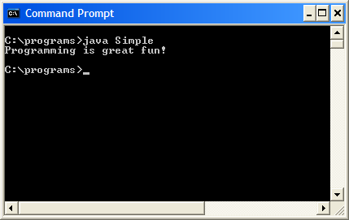
Console Output
Some of the programs that you will write will run in a console window.
2-<number>

Slide 18
Console Output
The console window that starts a Java application is typically known as the standard output device.
The standard input device is typically the keyboard.
Java sends information to the standard output device by using a Java class stored in the standard Java library.
2-<number>

Slide 19
Console Output
Java classes in the standard Java library are accessed using the Java Applications Programming Interface (API).
The standard Java library is commonly referred to as the Java API.
2-<number>

Slide 20
Console Output
The previous example uses the line:
  System.out.println("Programming is great fun!");
This line uses the System class from the standard Java library.
The System class contains methods and objects that perform system level tasks.
The out object, a member of the System class, contains the methods print and println.
2-<number>

Slide 21
Console Output
The print and println methods actually perform the task of sending characters to the output device.
The line:
  System.out.println("Programming is great fun!");
  is pronounced: System dot out dot println …
The value inside the parenthesis will be sent to the output device (in this case, a string).
2-<number>

Slide 22
Console Output
The println method places a newline character at the end of whatever is being printed out.
The following lines:
    System.out.println("This is being printed out");
    System.out.println("on two separate lines.");
  Would be printed out on separate lines since the first statement sends a newline command to the screen.
2-<number>

Slide 23
Console Output
The print statement works very similarly to the println statement.
However, the print statement does not put a newline character at the end of the output.
The lines:
    System.out.print("These lines will be");
    System.out.print("printed on");
    System.out.println("the same line.");
  Will output:
  These lines will beprinted onthe same line.
  Notice the odd spacing? Why are some words run together?
2-<number>

Slide 24
Console Output
For all of the previous examples, we have been printing out strings of characters.
Later, we will see that much more can be printed.
There are some special characters that can be put into the output.
System.out.print("This line will have a newline at the end.\n");
The \n in the string is an escape sequence that represents the newline character.
Escape sequences allow the programmer to print characters that otherwise would be unprintable.
2-<number>

Slide 25
Unicode
Internally, characters are stored as numbers.
Character data in Java is stored as Unicode characters.
The Unicode character set can consist of 65536 (2¹⁶) individual characters.
This means that each character takes up 2 bytes in memory.
The first 256 characters in the Unicode character set are compatible with the ASCII* character set.
*American Standard Code for Information Interchange
2-<number>

Slide 26
Variable Assignment and Initialization
// This program shows variable assignment.
public class Initialize
{
public static void main(String[] args)
{
int month, days;
month = 2;
days = 28;
System.out.println("Month " + month + " has " +
days + " Days.");
}
}
The variables must be declared before they can be used.
2-<number>

Slide 27
Variable Assignment and Initialization
// This program shows variable assignment.
public class Initialize
{
public static void main(String[] args)
{
int month, days;
month = 2;
days = 28;
System.out.println("Month " + month + " has " +
days + " Days.");
}
}
Once declared, they can then receive a value (initialization);
however the value must be compatible with the variable’s
declared type.
2-<number>

Slide 28
Variable Assignment and Initialization
// This program shows variable assignment.
public class Initialize
{
public static void main(String[] args)
{
int month, days;
month = 2;
days = 28;
System.out.println("Month " + month + " has " +
days + " Days.");
}
}
After receiving a value, the variables can then be used in
output statements or in other calculations.
2-<number>

Slide 29
Variable Assignment and Initialization
// This program shows variable initialization.
public class Initialize
{
public static void main(String[] args)
{
int month = 2, days = 28;
System.out.println("Month " + month + " has " +
days + " Days.");
}
}
Local variables can be declared and initialized on
the same line.
2-<number>

Slide 30
Variable Assignment and Initialization
Variables can only hold one value at a time.
Local variables do not receive a default value.
Local variables must have a valid type in order to be used.
public static void main(String [] args)
{
int month, days; //No value given…
System.out.println("Month " + month + " has “
+ days + " Days.");
}
Trying to use uninitialized variables will generate a Syntax Error when the code is compiled.
2-<number>

Slide 31
Commenting Code
Javadoc comments can be built into HTML documentation.
See example: Comment3.java
To create the documentation:
  Run the javadoc program with the source file as an argument
  Ex: javadoc Comment3.java
The javadoc program will create index.html and several other documentation files in the same directory as the input file.
2-<number>

Slide 32
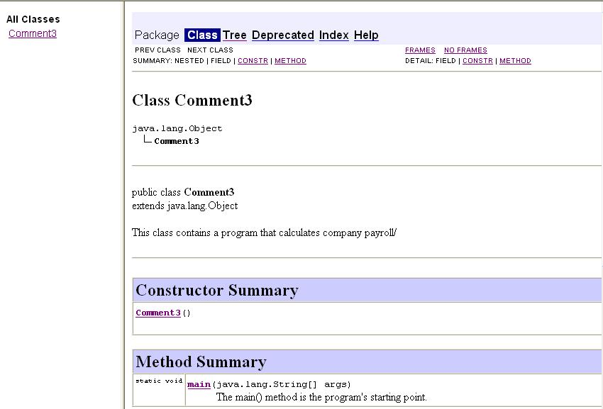
Commenting Code
Example HTML documentation:
2-<number>

Slide 33
Indentation
Programs should use proper indentation.
Each block of code should be indented a few spaces from its surrounding block.
Two to four spaces are sufficient.
Tab characters should be avoided.
  Tabs can vary in size between applications and devices.
  Most programming text editors allow the user to replace the tab with spaces.
See example: Readable.java
2-<number>

Slide 34
Scope
Scope refers to the part of a program that has access to a variable’s contents.
Variables declared inside a method (like the main method) are called local variables.
Local variables’ scope begins at the declaration of the variable and ends at the end of the method in which it was declared.
See example: Scope.java (This program contains an intentional error.)
2-<number>

Slide 35
The Parse Methods
  // Store 1 in bVar.
  byte bVar = Byte.parseByte("1");
  // Store 2599 in iVar.
  int iVar = Integer.parseInt("2599");
  // Store 10 in sVar.
  short sVar = Short.parseShort("10");
  // Store 15908 in lVar.
  long lVar = Long.parseLong("15908");
  // Store 12.3 in fVar.
  float fVar = Float.parseFloat("12.3");
  // Store 7945.6 in dVar.
  double dVar = Double.parseDouble("7945.6");
2-<number>

Slide 36
String Concatenation
Java commands that have string literals must be treated with care.
A string literal value cannot span lines in a Java source code file.
  System.out.println("This line is too long and now it has spanned more than one line, which will cause a syntax error to be generated by the compiler. ");
2-<number>

Slide 37
String Concatenation
The String concatenation operator can be used to fix this problem.
    System.out.println("These lines are " +
    "are now ok and will not " +
    "cause the error as before.");
String concatenation can join various data types.
    System.out.println("We can join a string to " +
    "a number like this: " + 5);
2-<number>

Slide 38
String Concatenation
The Concatenation operator can be used to format complex String objects.
    System.out.println("The following will be printed " +
    "in a tabbed format: " +
    "\n\tFirst = " + 5 * 6 + ", " +
    "\n\tSecond = " + (6 + 4) + "," +
    "\n\tThird = " + 16.7 + ".");
Notice that if an addition operation is also needed, it must be put in parenthesis.
2-<number>

